Slide 1


DEPARTMENT OF COMPUTER SCIENCE AND ENGINEERING MINI PROJECT FINAL REVIEW ON STOCK MARKET PRICE PREDICTION USING HISTORICAL DATA BATCH NO-15
VIGNAN’S INSTITUTE OF MANAGEMENT AND TECHNOLOGY FOR WOMEN
Team Members:
G.DISHITHA(20UP1A0570)
L.AKHILA(20UP1A0579)
V.AMITHA(20UP1A05A4)
N.SANDHYA(20UP1A0591)
Project Guide:
MISS SAMREEN BEGUM

Slide 2
CONTENTS
Introduction
Abstract
Existing System
Proposed System
System Requirements
Modules
System Architecture
UML Diagrams
Result with Screenshots
Conclusion
References

Slide 3
INTRODUCTION
Predicting stock market prices using historical data is a complex and challenging task that has captured the attention of researchers, traders, and investors for decades. The stock market is influenced by a multitude of factors, including economic indicators, company performance, geopolitical events, and investor sentiment, making it inherently volatile and difficult to forecast accurately. Nevertheless, the use of historical data and various predictive techniques has become increasingly popular as investors seek to gain a competitive edge in their decision-making processes. we will explore the fundamental concepts and approaches associated with stock market price prediction

Slide 4
ABSTRACT
Python has been successfully used to predict stock prices. In Stock Market Prediction, the aim is to predict the future value of the financial stocks of a company. The recent trend in stock market prediction technologies is the use of machine learning which makes predictions based on the values of current stock market indices by training on their previous values. Machine learning itself employs different models to make prediction easier and authentic. This proposed system focuses on the use of LSTM based Machine learning to predict stock values. LSTMs are very good at handling problems with sequence prediction because they can store past data. Factors considered are open, close, low, high and volume . In our case, this is crucial since examining a stock's historical price can assist anticipate its future price. You can develop a model that forecasts whether the price of a stock will climb or fall while also forecasting that the actual price of the stock will increase and this is based on the factors considered are open, close, low, high and volume.

Slide 5
EXISTING SYSTEM
The current methods of stock market price prediction rely on traditional statistical models and technical indicators. These approaches often lack the ability to capture complex patterns and trends present in the data, leading to less accurate predictions. Moreover, they may not efficiently handle the vast amount of historical data available, limiting their forecasting capabilities.
DISADVANTAGES:
Lack the ability to capture complex patterns and trends present in the data
Leading to less / limited accurate predictions
They may not efficiently handle the vast amount of historical data available
Changing market conditions
Lack of fundamental analysis

Slide 6
PROPOSED SYSTEM
The proposed system introduces a cutting-edge approach to stock market price prediction, leveraging the power of neural networks, specifically Long Short-Term Memory (LSTM) networks, in conjunction with historical data.
In this system, historical stock market data will be preprocessed and fed into the neural network architecture. The network will employ multiple layers to learn from the sequential patterns and relationships present in the historical data. This enables the model to capture both short-term fluctuations and long-term trends, enhancing its predictive capabilities.

Slide 7
SYSTEM REQUIREMENTS
SOFTWARE REQUIREMENTS
Python IDE
Machine Learning Library
HARDWARE REQUIREMENTS
OS-WINDOWS (Latest Version)

Slide 8
MODULES
1. numpy: Used for numerical operations, array manipulation, and handling numerical data efficiently.
2. matplotlib.pyplot: Used for creating data visualizations, including plotting time series data in this code.
3. pandas: Used for data manipulation and analysis, especially for reading and working with CSV files in a tabular format.
4. sklearn.preprocessing.MinMaxScaler: Part of the scikit-learn library, this module is used for scaling (normalizing) the input data to a specified range, typically between 0 and 1, to improve model training.

Slide 9
5. keras.models.Sequential, keras.layers: These modules are part of the Keras library (integrated into TensorFlow as tf.keras). They are used for building and training neural network models. Specifically, you're using Sequential models to create a stacked LSTM (Long Short-Term Memory) neural network.
6. Input Handling: The code starts by taking user input for selecting a company's stock data, which is stored in a CSV file. Depending on the company selected, the corresponding CSV file is read using pandas.
7. Data Scaling: The stock price data (in this case, the 'Close' prices) is scaled using sklearn.preprocessing.MinMaxScaler to normalize the values between 0 and 1.
8. Data Preparation: The code prepares the data for training the LSTM model. It creates sequences of historical stock prices (input features) and the corresponding next-day stock price (target or label) as training samples. These sequences are used to train the LSTM model.

Slide 10
9. LSTM Model: The LSTM model is defined using keras.models.Sequential. It consists of three LSTM layers, each followed by a dropout layer to prevent overfitting, and finally, a dense output layer.
10. Model Compilation: The model is compiled using the 'adam' optimizer and the mean squared error ('mean_squared_error') as the loss function.
11. Model Training: The model is trained on the prepared training data (x_train and y_train) using the model.fit method. It goes through 25 epochs with a batch size of 32.
12. Testing and Visualization: The model is tested on the same data used for training to visualize its performance. The actual and predicted stock prices are plotted using matplotlib.pyplot. Additionally, the code attempts to make a future prediction based on the last available data point.

Slide 11
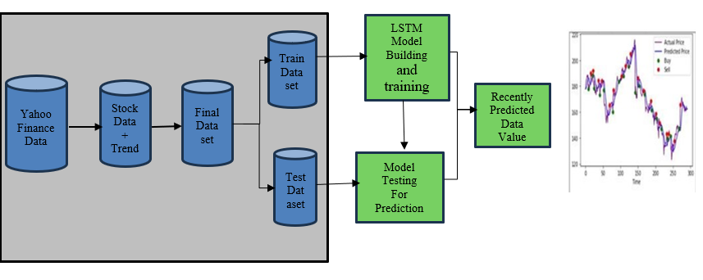
SYSTEM ARCHITECTURE
Fig 1: System Architecture

Slide 12
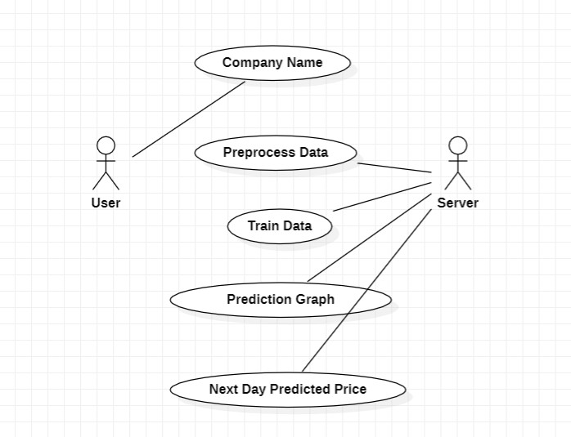
UML DIAGRAMS:
USE CASE DIAGRAM:
Fig 2: Use Case Diagram

Slide 13
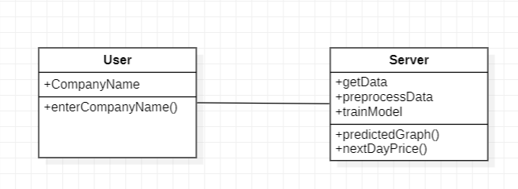
CLASS DIAGRAM:
Fig 3: Class Diagram

Slide 14
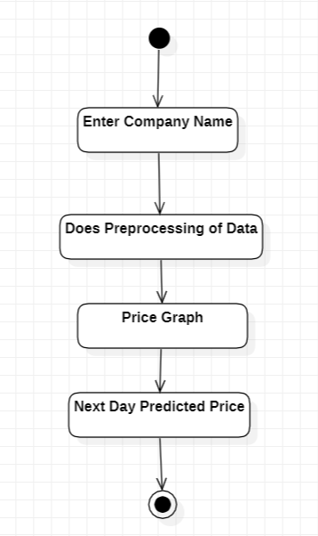
ACTIVITY DIAGRAM:
Fig 4: Activity Diagram

Slide 15
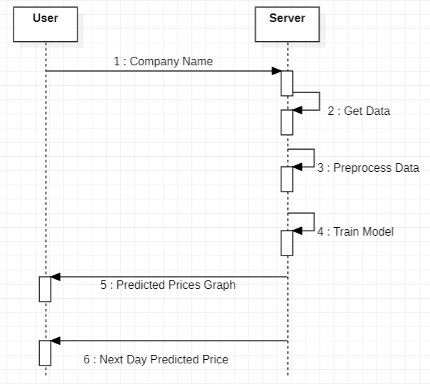
SEQUENTIAL DIAGRAM:
Fig 5: Sequential Diagram

Slide 16
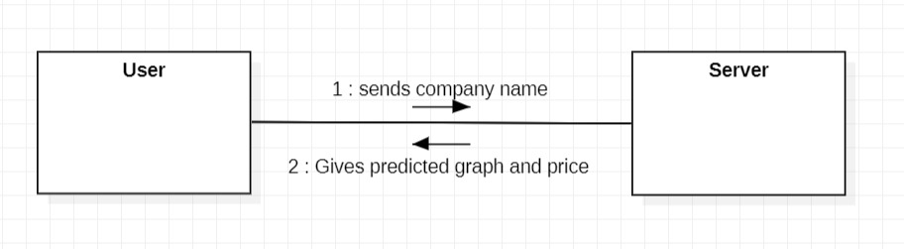
COMMUNICATION DIAGRAM:
Fig 6: Communication Diagram

Slide 17
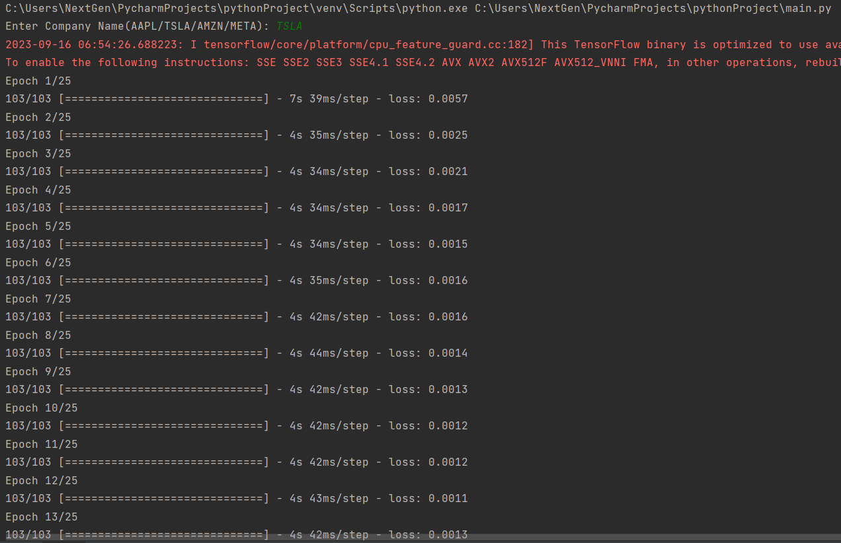
FINAL RESULT SCREENSHOTS
Fig 7: Result part-1

Slide 18
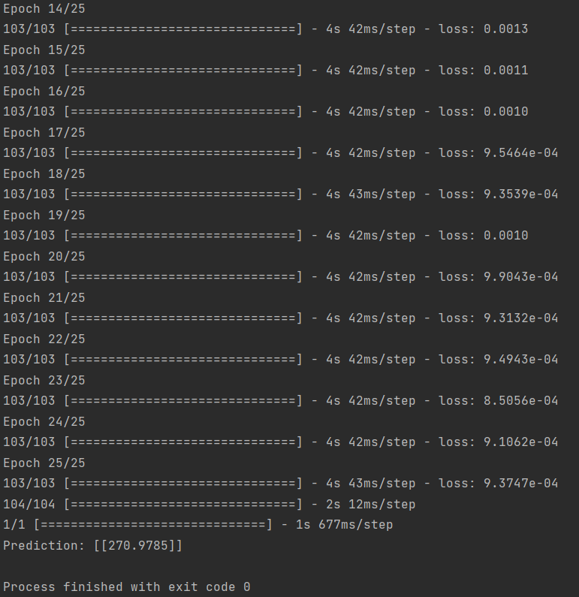
Fig 8:Result part -2

Slide 19
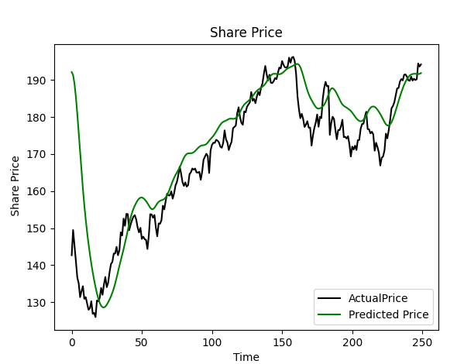
Fig 9: Predicted Graph

Slide 20
CONCLUSION
In summary, the proposed system leverages the potential of neural networks to revolutionize stock market price prediction by using LSTM . By employing advanced learning techniques on historical data, this system empowers investors with valuable foresight, enabling them to navigate the complexities of the stock market and make informed choices with greater confidence.

Slide 21
REFERENCES
[1] M. Usmani, S. H. Adil, K. Raza and S. S. A. Ali, "Stock market prediction using machine learning techniques," 2016 3rd International Conference on Computer and Information Sciences (ICCOINS), Kuala Lumpur, 2016, pp. 322-327.
[2] K. Raza, "Prediction of Stock Market performance by using machine learning techniques," 2017 International Conference on Innovations in Electrical Engineering and Computational Technologies (ICIEECT), Karachi, 2017, pp. 1-1.
[3] H. Gunduz, Z. Cataltepe and Y. Yaslan, "Stock market direction prediction using deep neural networks," 2017 25th Signal Processing and Communications Applications Conference (SIU), Antalya, 2017, pp. 1-4.
[4] M. Billah, S. Waheed and A. Hanifa, "Stock market prediction using an improved training algorithm of neural network," 2016 2nd International Conference on Electrical, Computer & Telecommunication Engineering (ICECTE), Rajshahi, 2016, pp. 1-4.

Slide 22


